Slide 1

Project: Predicting Loan Defaults with Logistic Regression
Walid Farah Djama
PGD-IN data science
ENROLLMENT NUMBER | A | 5 | 2 | 5 | 1 | 3 | 4 | 5 | 2 | 0 | 0 | 0 | 6

Slide 2
This project is about predicting loan defaults using statistical analysis, and evaluation of probable logistic regression model. I'm using a dataset of 32 variables. And I have used R language( RStudio) for the analysis.
- Introduction

Slide 3
In my analysis have used several comprehensive aspect of generalized linear model in order to optimize and predict the loans status as well as predict profit that based on my model. I have analysed it in terms of correct prediction percent of fully paid and default loan’s status and from there I was able to predict a higher percentage of the profit.
- Introduction

Slide 4
I have loaded all the library required for my analysis at first the loaded the dataset into the system. Right after that I have started preparing/cleaning the data. I replaced original “n/a”, missing data, with the default value of NA for the purposes of my analysis. I usually impute missing if its more than 5% but in this case the data is less than 5% so I choosed to just drop as it will not have of a effect on my analysis. As well I drop some unnecessary variables. Our final dataset contains 28 variables instead of 32 Variables
Preparing and Exploring the data

Slide 5
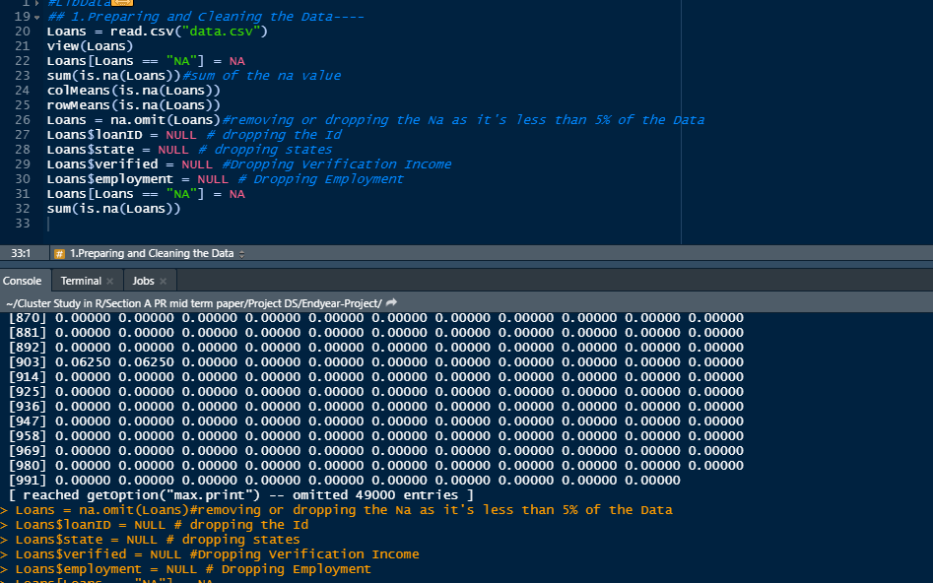
Preparing /Cleaning

Slide 6
And naturally after finishing with the cleaning the I have started exploring and transforming the data as factor and characters and integer properly. Checked the correlation between the variables and change the Loans status into categorical factor of Good and Bad Loans. And check the correlation using the Pearson method to see how they are correlated.
Exploring and Transforming the Data

Slide 7
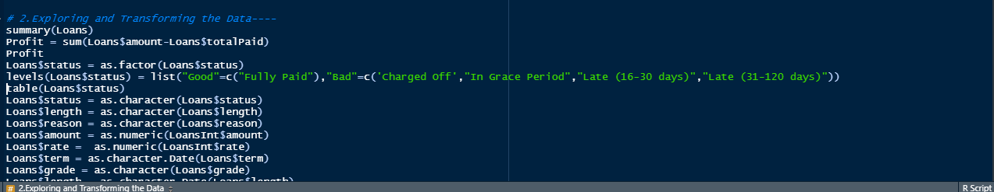
Exploring and Transforming the Data

Slide 8
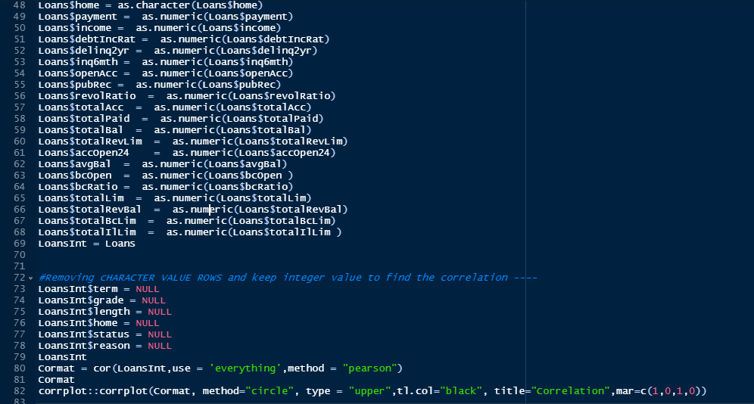
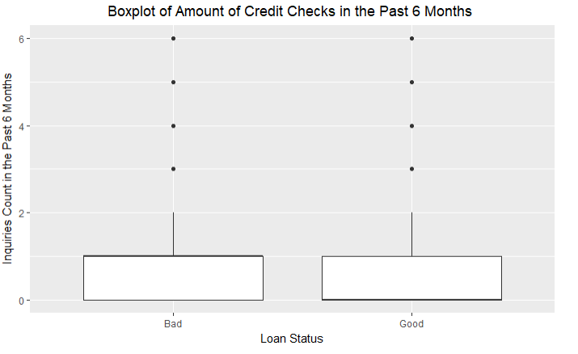
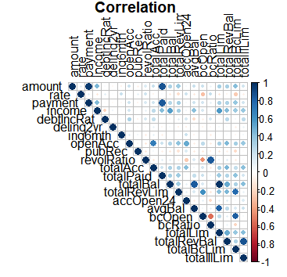
Exploring and Transforming the Data

Slide 9
I have divided the data into two part Traindata set and test data set. I saved 80% of the in the train data set and 20% in the test set. Keeping in mind the randomization.
The Preparing Train and test data for Modelisation

Slide 10
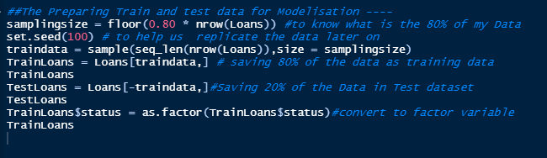
The Preparing Train and test data for the modal

Slide 11
The logistic model that I used is generalized Linear model of a binomial family. The generalized linear model (GLM) is a flexible generalization of ordinary linear regression that allows for response variables that have error distribution models other than a normal distribution.So I call a glm where I used the factor of the as status against all other variable and the result was not statisfactory it was unbalanced as they were more good than bad in a greater value.
The Logistic Model

Slide 12
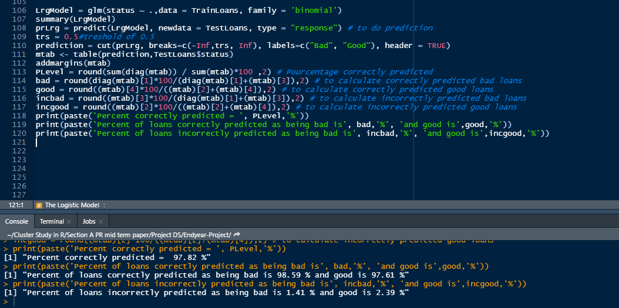
- The Logistic Model

Slide 13
Based on the results produced, we can see that the full model produced correctly predicted results of 97.82% and the percent of bad loans were correctly predicted as being bad is 98.59% were correctly predicted). As for good loans we have had 97.61 %"predicted as good of correctly. I Can note that with current model the correct prediction of the bad loan is very higher than the Good loan and needs improvement.
Balancing the status

Slide 14
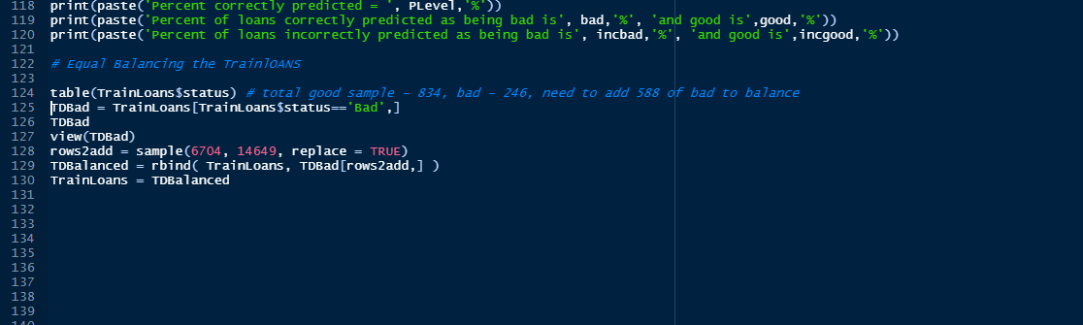
As previously mentioned our data set is imbalanced as we have far more “Good” than “Bad” loans; Therefore for the purpose of our analysis we will perform oversampling, artificially increase the number of “Bad” cases to match the same amount of “Good” cases
Balancing the status

Slide 15
With new balanced data the prediction as fallen a bit of Percent correctly predicted to 96.92 % but Percent of loans correctly predicted as being bad is 92.83 % and good is 98.15 %“ as good was good.
Balanced data

Slide 16
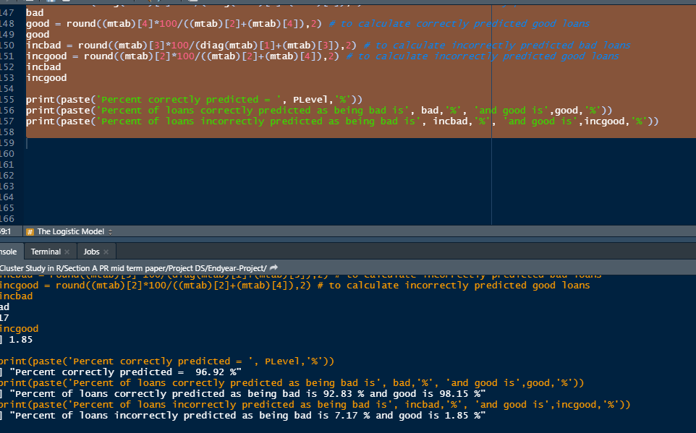
Balancing the status

Slide 17
Akaike’s information criterion (AIC) compares the quality of a set of statistical models to each other. The Akaike information criterion (AIC) is an estimator of prediction error and thereby relative quality of statistical models for a given set of data. Given a collection of models for the data, AIC estimates the quality of each model, relative to each of the other models. So I used Stepwise Regression and Model Selection TO FIND BEST AIC MODEL by using both direction.
Akaike’s Information Criterion

Slide 18
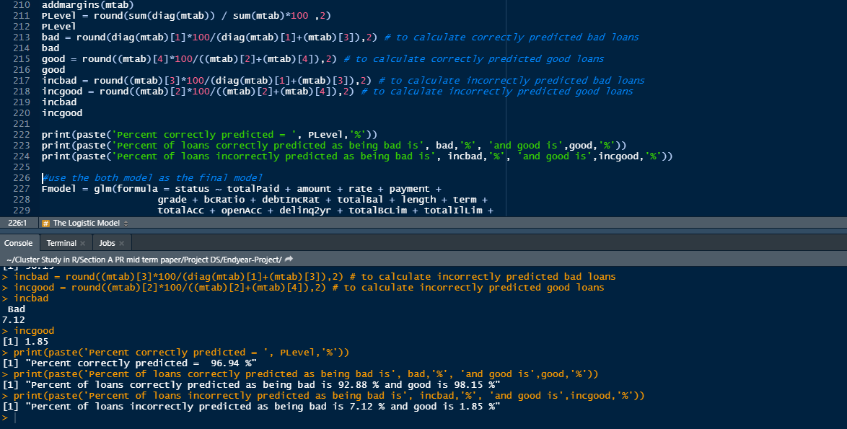
Stepwise Regression and Model Selection Improvement Akaike’s Information Criterion

Slide 19
I have optimized the threshold three model with 0.8 threshold the accuracy has dropped meanwhile at 0.3 it was far with 97.51 with considerable profit .
Threshold optimatisation for profit

Slide 20
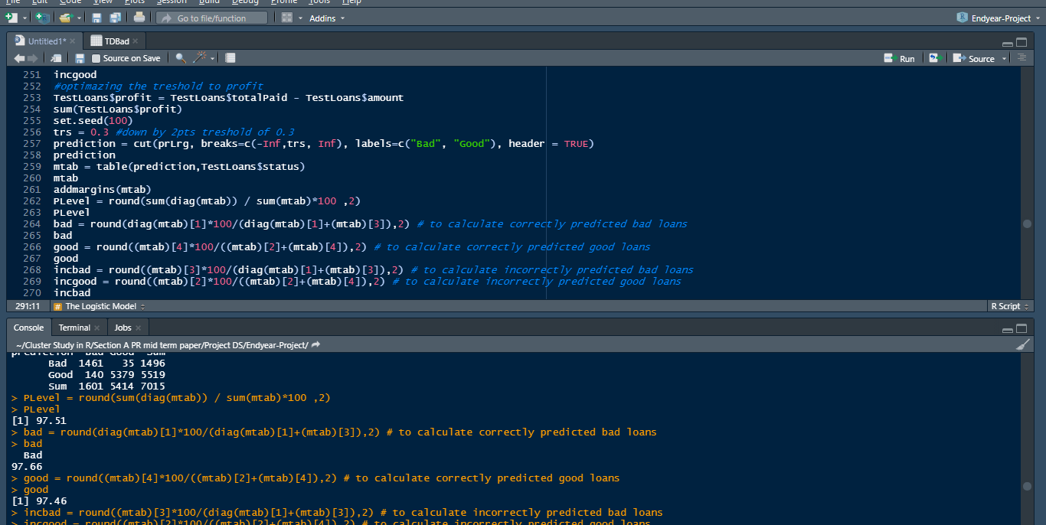
Threshold optimalisation for profit

Slide 21
The determined model provides an overall accuracy of 78.15% where predicted correctly fully paid loans are at 93.26% with a proposed threshold of 0.3 with our estimated predicted profit of $ 12761340 However, the trade off of the profit comes with the price of denying some of the loans that actually would have been fully paid, the loan’s status that was incorrectly predicted is 1.17%. The variation of the threshold can increase and decrease the percent of correctly predicted status, if we look at the graph of threshold level comparison to predicted profit on the right we will note that the profit is increasing up until threshold of about 0.3 and then decreasing as it goes up. Therefore, by implementing the proposed model the bank can increase their potential profit by $ 10855971.
Conclusion

Slide 22
Therefore, the improved model we suggest for the bank to predict the loan status is the following: status ~ totalPaid + amount + rate + payment + grade + bcRatio + debtIncRat + totalBal + length + term +totalAcc + openAcc + delinq2yr + totalBcLim + totalIlLim +totalRevBal + totalLim + totalRevLim + revolRatio + accOpen24 + bcOpen with 0.3 threshold applied.
conclusion

